Slide 1

WEB SCAPPING USING PYTHON

Slide 2

Web Scrapping - Holland & Knight
Requirements:
Scrap data from website
Build Database schema design
Build flask API
Create table
Insert records
View inserted records
Load scraped data into SQLITE using Flask API
Website Link to scrap : https://www.hklaw.com/en/professionals?practice=3143ab35-d1e0-4345-bcf9-a5cb09120539
GitHub Link : https://github.com/Harsh03331/HKLAW_PROJECT.git
Done By:
KOKILAPRIYA S

Slide 3
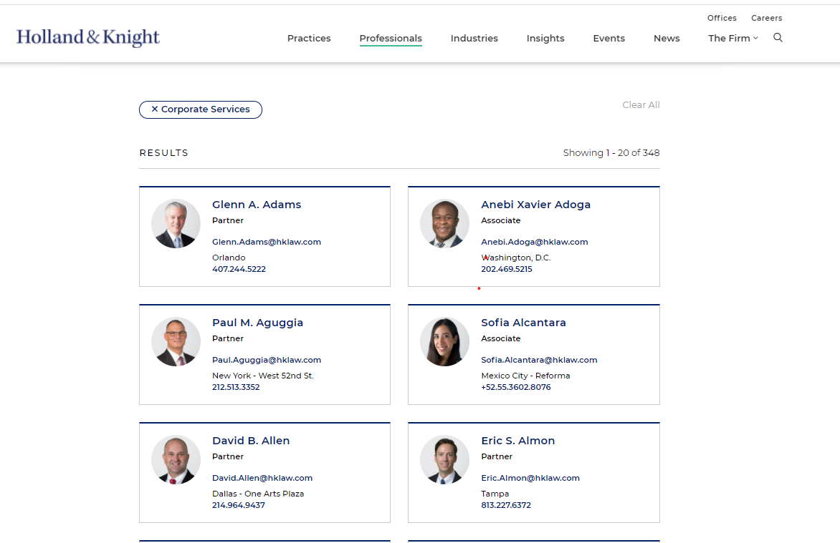
WEBSITE
Data points :
Name
Role
Email
City
Phone
Page URL

Slide 4
THANK YOU

